Slide 1

Calculation Policy Subtraction – Years 1-6
Aintree Davenhill Primary School

Slide 2
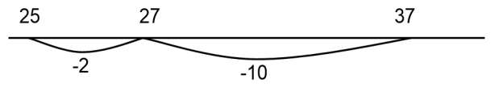
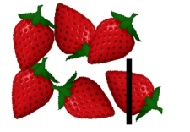
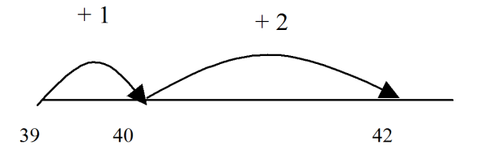
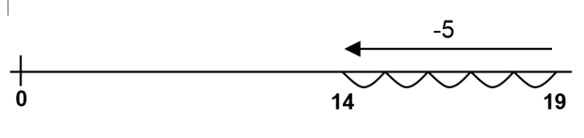
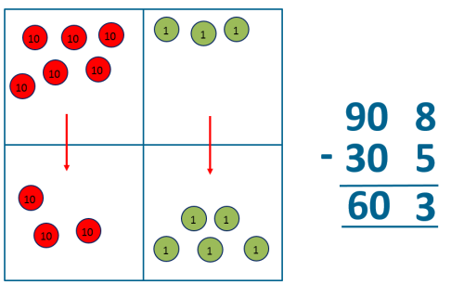
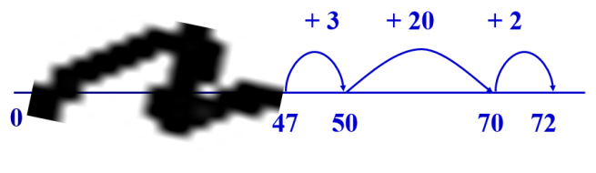
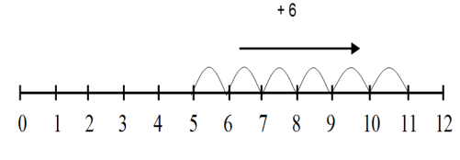
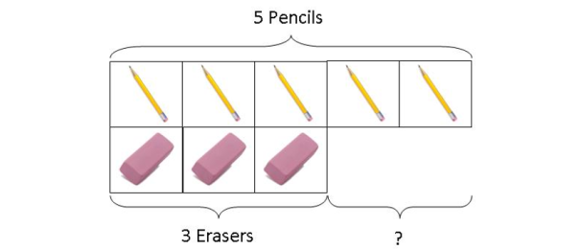
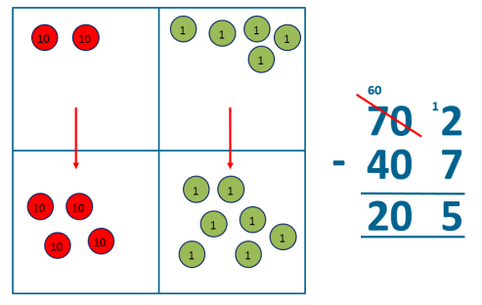
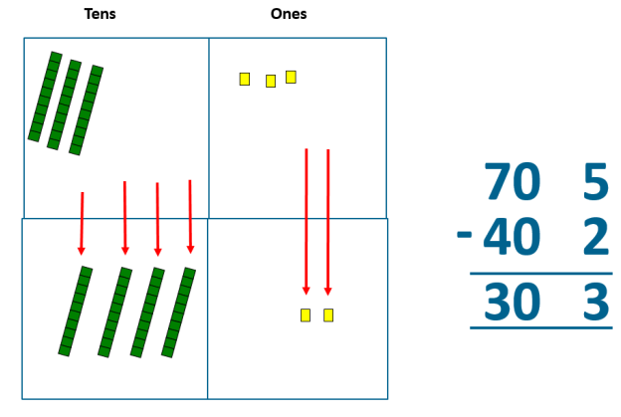
Year 1 | Year 2 | Year 3
Missing number problems, e.g. 7 = □ - 9; 20 - □ = 9; 15 – 9 = □; □ - □ = 11; 16 – 0 = □. Use concrete objects and pictorial representations. If appropriate, progress from using number lines with every number shown to number lines with significant numbers shown. Understand subtraction as take-away: Understand subtraction as finding the difference: The above model would be introduced with concrete objects which children can move (including cards with pictures) before progressing to pictorial representation. The use of other images is also valuable for modelling subtraction e.g. Numicon, bundles of straws, Dienes apparatus, multi-link cubes, bead strings. | Missing number problems e.g. 52 – 8 = □; □ – 20 = 25; 22 = □ – 21; 6 + □ + 3 = 11. It is valuable to use a range of representations (also see Y1). Continue to use number lines to model take-away and difference. e.g. The link between the two may be supported by an image like this, with 47 being taken away from 72, leaving the difference, which is 25. Towards written methods Recording addition and subtraction in expanded columns can support understanding of the quantity aspect of place value and prepare for efficient written methods with larger numbers. The numbers may be represented with Dienes apparatus. e.g. 75 – 42 | Missing number problems e.g. □ = 43 – 27; 145 – □ = 138; 274 – 30 = □; 245 – □ = 195; 532 – 200 = □; 364 – 153 = □. Mental methods should continue to develop, supported by a range of models and images, including the number line. The bar model should continue to be used to help with problem solving (see Y1 and Y2). Children should make choices about whether to use complementary addition or counting back, depending on the numbers involved. Written methods (progressing to 3-digits) Introduce expanded column subtraction with no decomposition, modelled with place value counters. (Dienes could be used for those who need a less abstract representation.) For some children this will lead to exchanging, modelled using place value counters (or Dienes). A number line and expanded column method may be compared next to each other. Some children may begin to use a formal columnar algorithm, initially introduced alongside the expanded method. The formal method should be seen as a more streamlined version of the expanded method, not a new method.
Obj
Gui
Vid
Ex
Obj
Gui
Vid
Ex
Obj
Gui
Vid
Ex

Slide 3
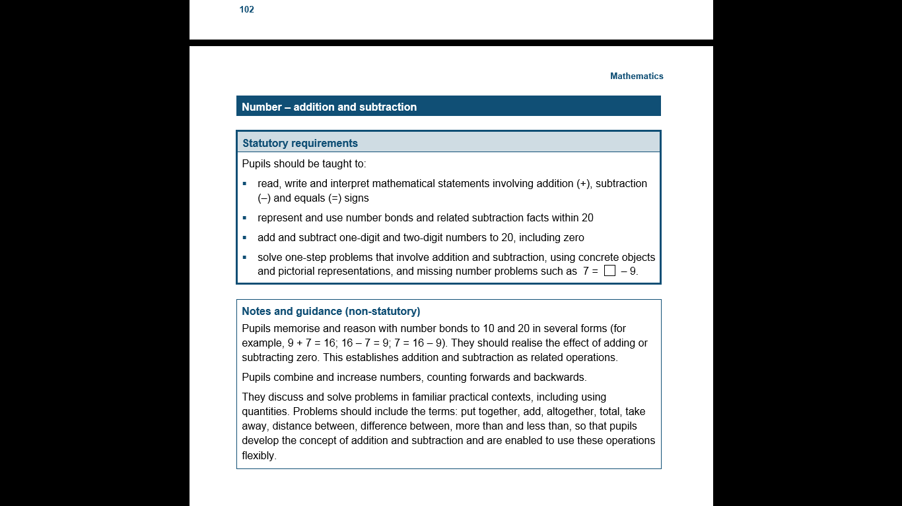
The National Curriculum in England Year 1 Objectives
Return

Slide 4
The National Curriculum in England Year 1 Guidance
Return

Slide 5
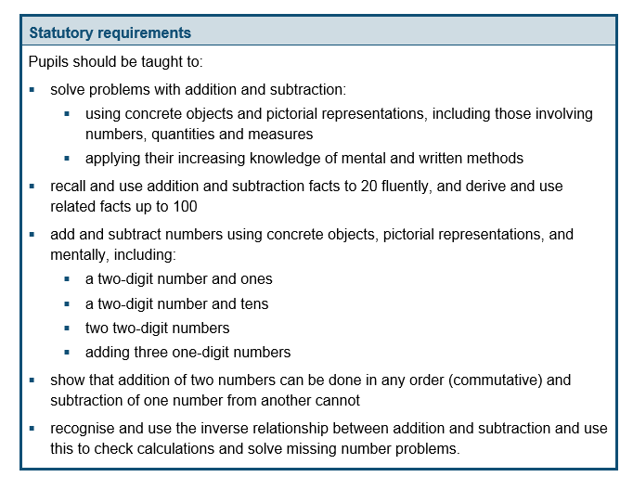
The National Curriculum in England Year 2 Objectives
Return

Slide 6
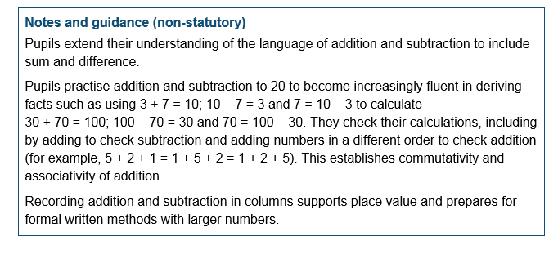
The National Curriculum in England Year 2 Guidance
Return

Slide 7
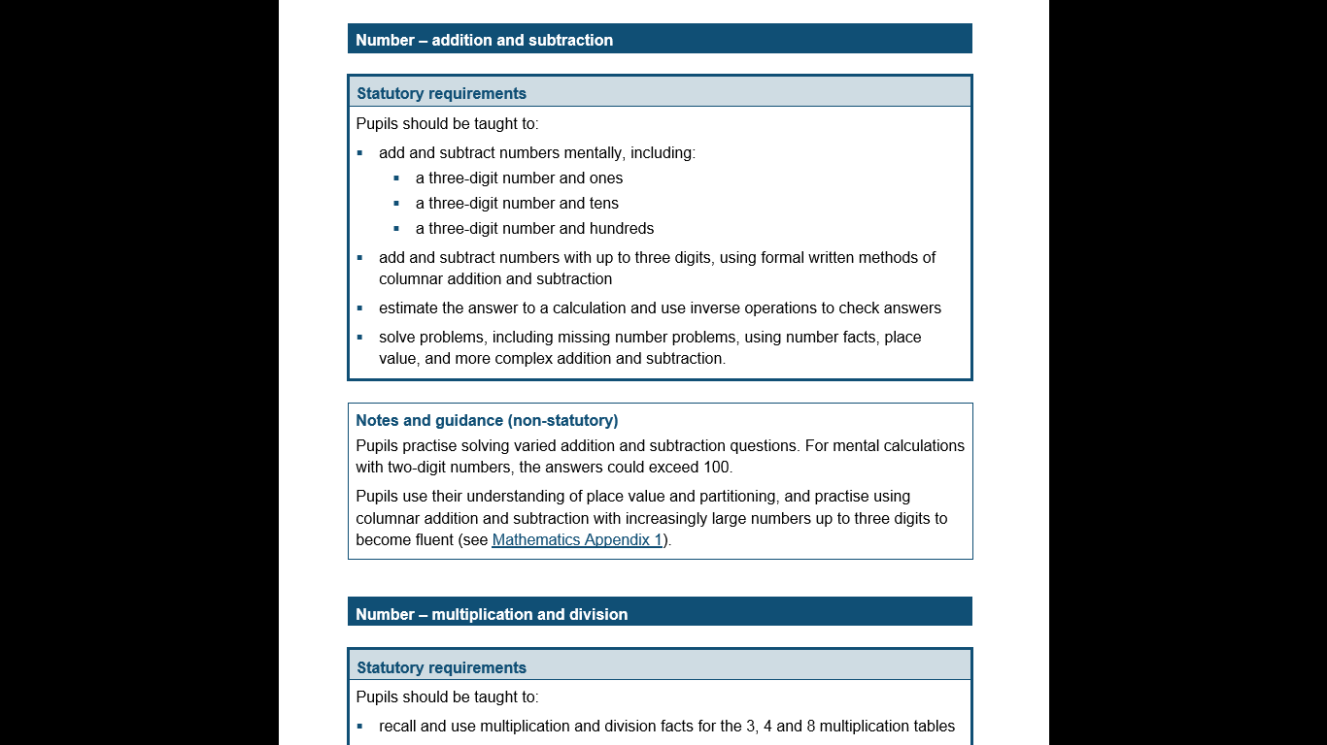
The National Curriculum in England Year 3 Objectives
Return

Slide 8
The National Curriculum in England Year 3 Guidance
Return

Slide 9
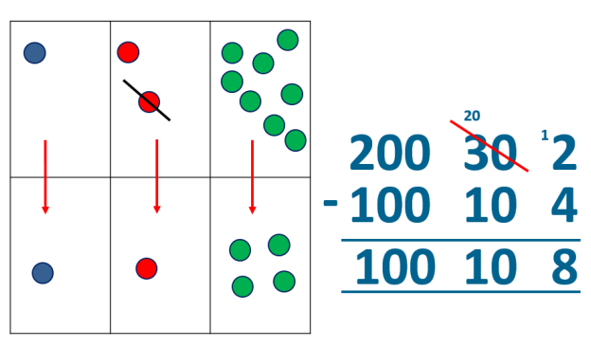
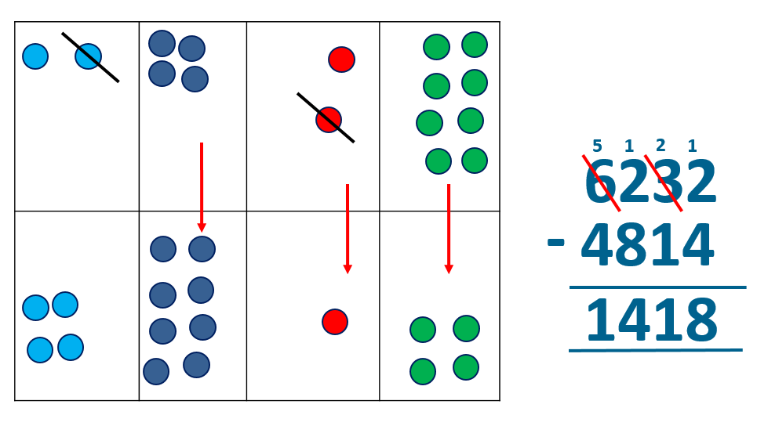
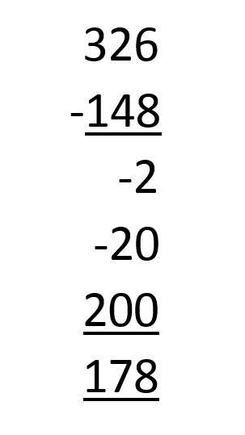
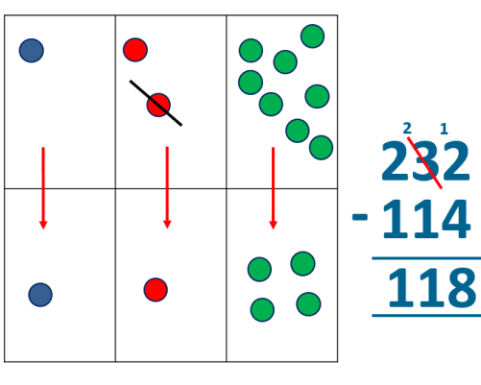
Year 4 | Year 5 | Year 6
Missing number/digit problems: 456 + □ = 710; 1□7 + 6□ = 200; 60 + 99 + □ = 340; 200 – 90 – 80 = □; 225 - □ = 150; □ – 25 = 67; 3450 – 1000 = □; □ - 2000 = 900. Mental methods should continue to develop, supported by a range of models and images, including the number line. Written methods (progressing to 4-digits) Expanded column subtraction with decomposition, modelled with place value counters, progressing to calculations with 4-digit numbers. If understanding of the expanded method is secure, children will move on to the formal method of decomposition, which again can be initially modelled with place value counters. | Missing number/digit problems: 6.45 = 6 + 0.4 + □; 119 - □ = 86; 1 000 000 - □ = 999 000; 600 000 + □ + 1000 = 671 000; 12 462 – 2 300 = □. Mental methods should continue to develop, supported by a range of models and images, including the number line. Written methods (progressing to more than 4-digits) When understanding of the expanded method is secure, children will move on to the formal method of decomposition, which can be initially modelled with place value counters. Progress to calculating with decimals, including those with different numbers of decimal places. | Missing number/digit problems: □ and # each stand for a different number. # = 34. # + # = □ + □ + #. What is the value of □? What if # = 28? What if # = 21? 10 000 000 = 9 000 100 + □ 7 – 2 x 3 = □; (7 – 2) x 3 = □; (□ - 2) x 3 = 15 Mental methods should continue to develop, supported by a range of models and images, including the number line. Written methods As Year 5, progressing to larger numbers, aiming for both conceptual understanding and procedural fluency with decomposition to be secured. Teachers may also choose to introduce children to other efficient written layouts which help develop conceptual understanding. For example: Continue calculating with decimals, including those with different numbers of decimal places.
Obj
Gui
Vid
Ex
Obj
Gui
Vid
Ex
Obj
Gui
Vid
Ex

Slide 10
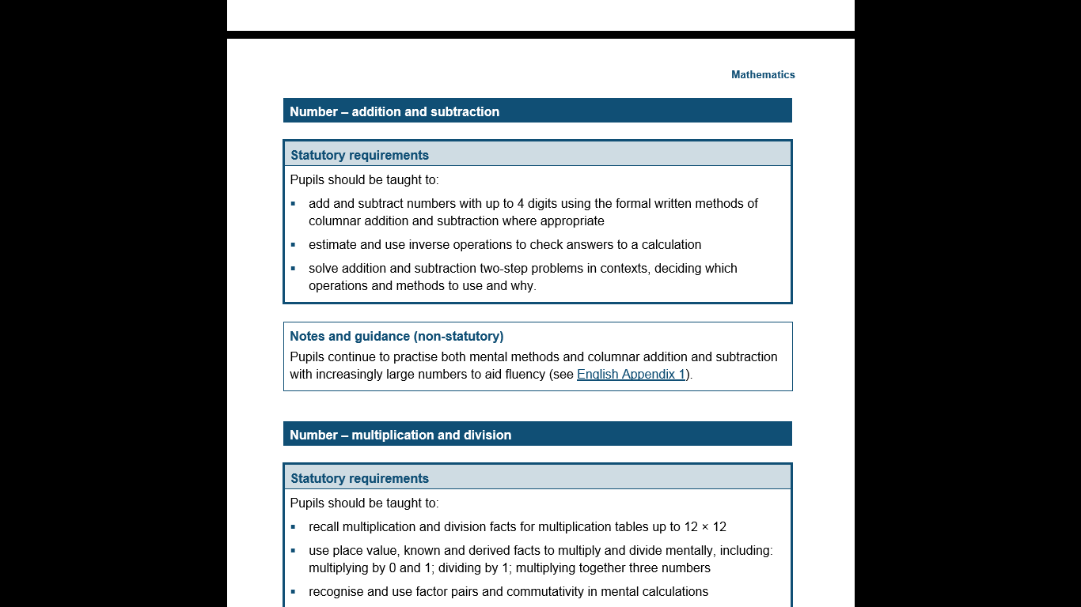
The National Curriculum in England Year 4 Objectives
Return

Slide 11
The National Curriculum in England Year 4 Guidance
Return

Slide 12
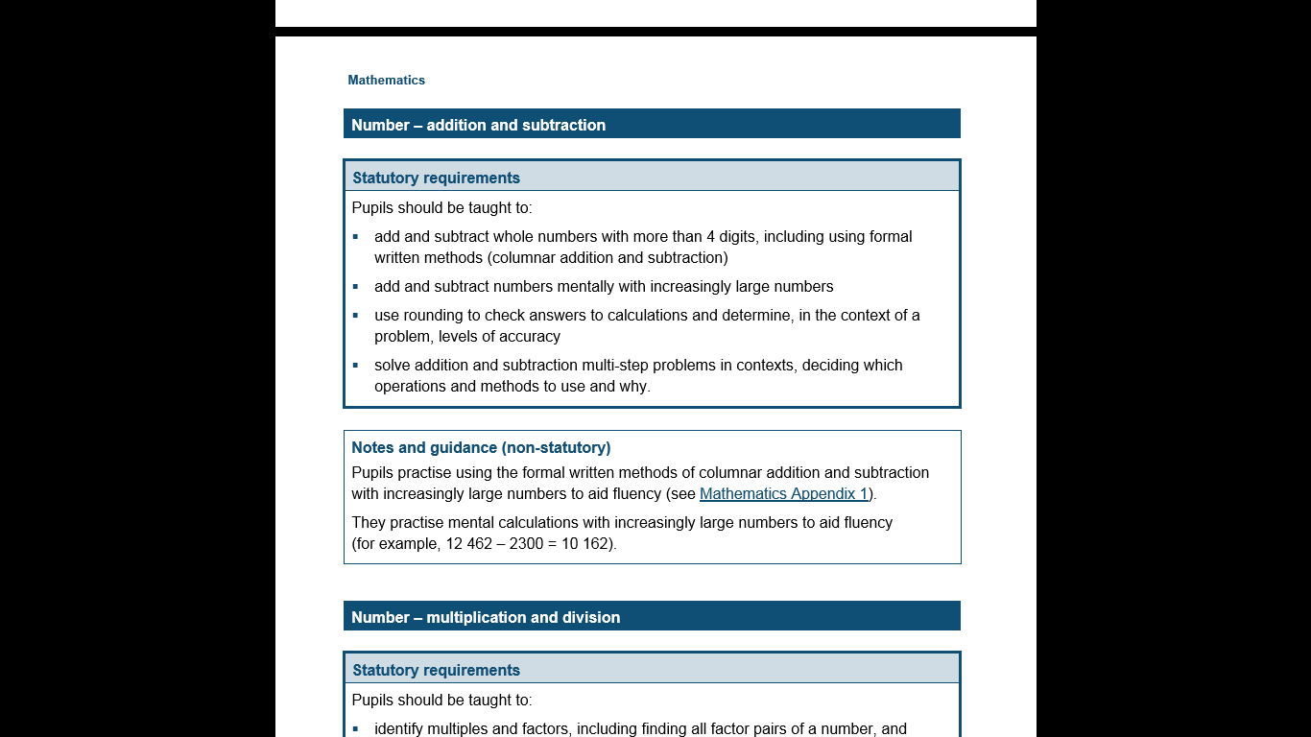
The National Curriculum in England Year 5 Objectives
Return

Slide 13
The National Curriculum in England Year 5 Guidance
Return

Slide 14
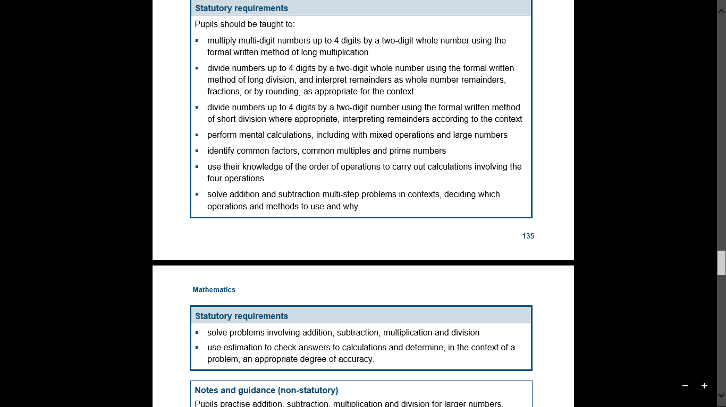
The National Curriculum in England Year 6 Objectives
Return

Slide 15
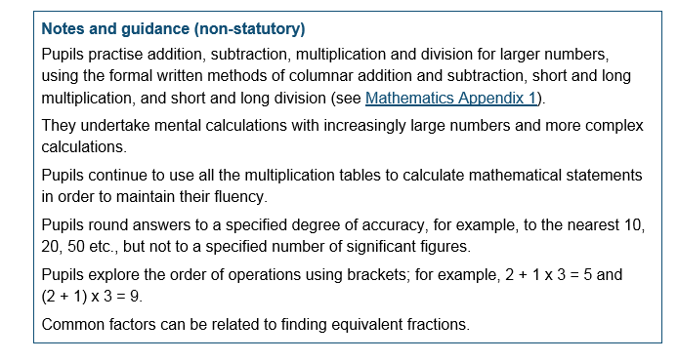
The National Curriculum in England Year 6 Guidance
Return

