Slide 1

Calculation Policy
Multiplication – Years 1-6
Aintree Davenhill Primary School

Slide 2

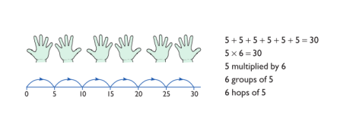
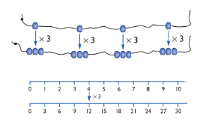
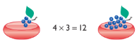
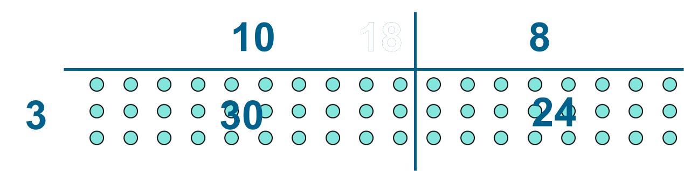
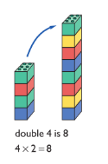
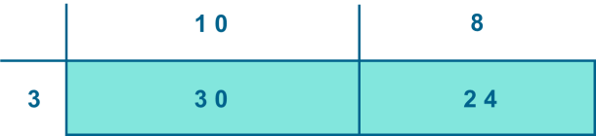
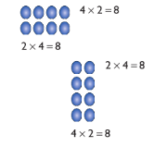
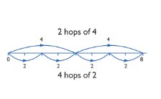
Year 1 | Year 2 | Year 3
Understand multiplication is related to doubling and combing groups of the same size (repeated addition). Washing line, and other practical resources for counting. Concrete objects, Numicon; bundles of straws; bead strings. Problem solving with concrete objects (including money and measures. Use cuissenaire to develop the vocabulary relating to ‘times’ – Pick up five, 4 times. Use arrays to understand multiplication can be done in any order (commutative). | Expressing multiplication as a number sentence using x. Using understanding of the inverse and practical resources to solve missing number problems. 7 x 2 = = 2 x 7 7 x = 14 14 = x 7 x 2 = 14 14 = 2 x x ⃝ = 14 14 = x ⃝ Develop understanding of multiplication using array and number lines (see Year 1). Include multiplications not in the 2, 5 or 10 times tables. Begin to develop understanding of multiplication as scaling (3 times bigger/taller). Doubling numbers up to 10 + 10. Link with understanding scaling. Using known doubles to work out double 2d numbers. (double 15 = double 10 + double 5) Towards written methods Use jottings to develop an understanding of doubling two digit numbers. 16 10 6 x2 x2 20 12 | Missing number problems Continue with a range of equations as in Year 2 but with appropriate numbers. Mental methods Doubling 2 digit numbers using partitioning. Demonstrating multiplication on a number line – jumping in larger groups of amounts. 13 x 4 = 10 groups 4 = 3 groups of 4 Written methods (progressing to 2d x 1d) Developing written methods using understanding of visual images. Develop onto the grid method. Give children opportunities for children to explore this and deepen understanding using Dienes apparatus and place value counters.
Obj
Gui
Ex
Obj
Gui
Vid
Ex
Obj
Gui
Vid
Ex

Slide 3
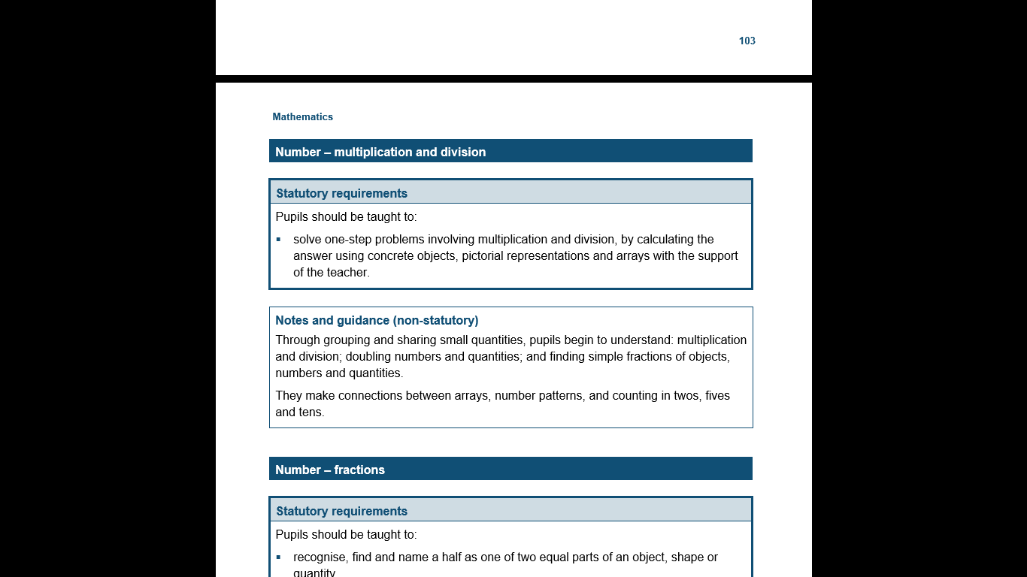
The National Curriculum in England
Year 1 Objectives
Return

Slide 4
The National Curriculum in England
Year 1 Guidance
Return

Slide 5
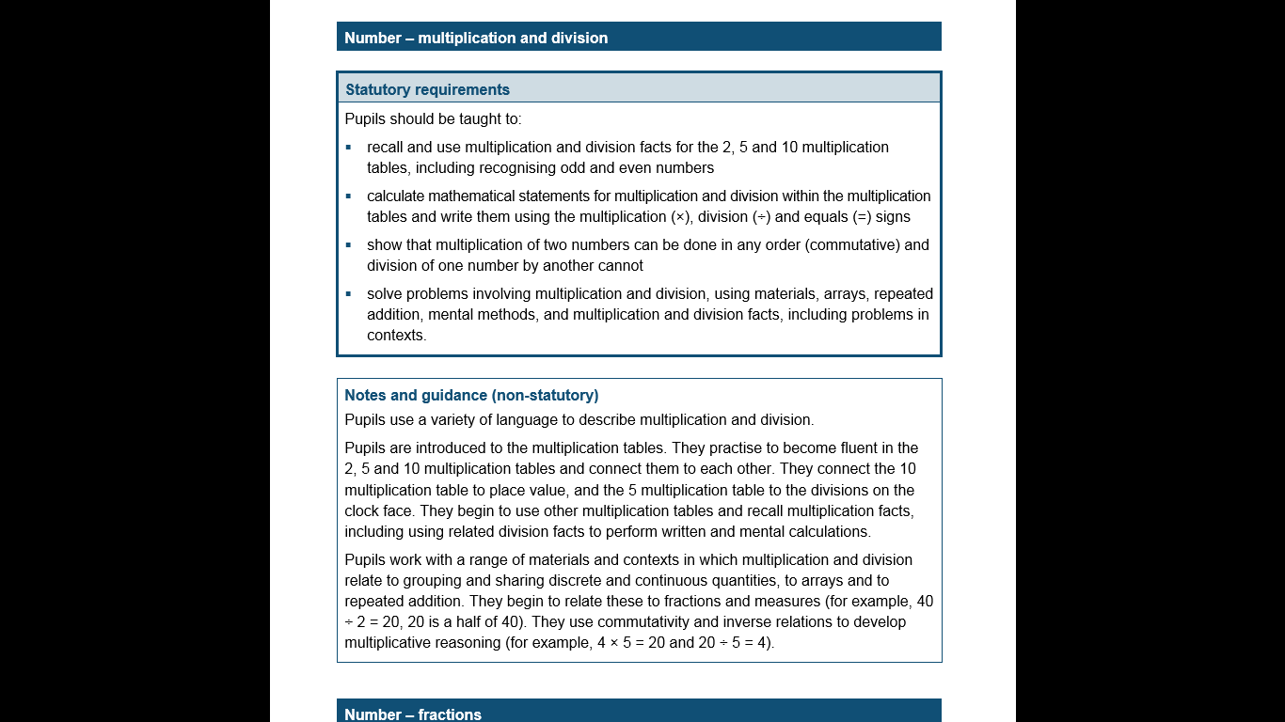
The National Curriculum in England
Year 2 Objectives
Return

Slide 6
The National Curriculum in England
Year 2 Guidance
Return

Slide 7
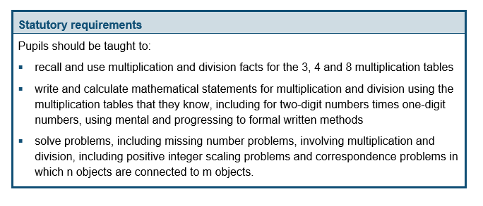
The National Curriculum in England
Year 3 Objectives
Return

Slide 8
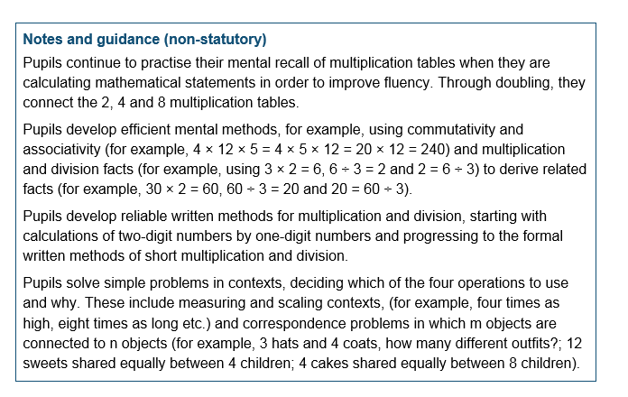
The National Curriculum in England
Year 3 Guidance
Return

Slide 9
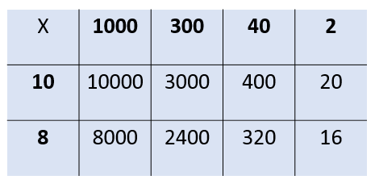
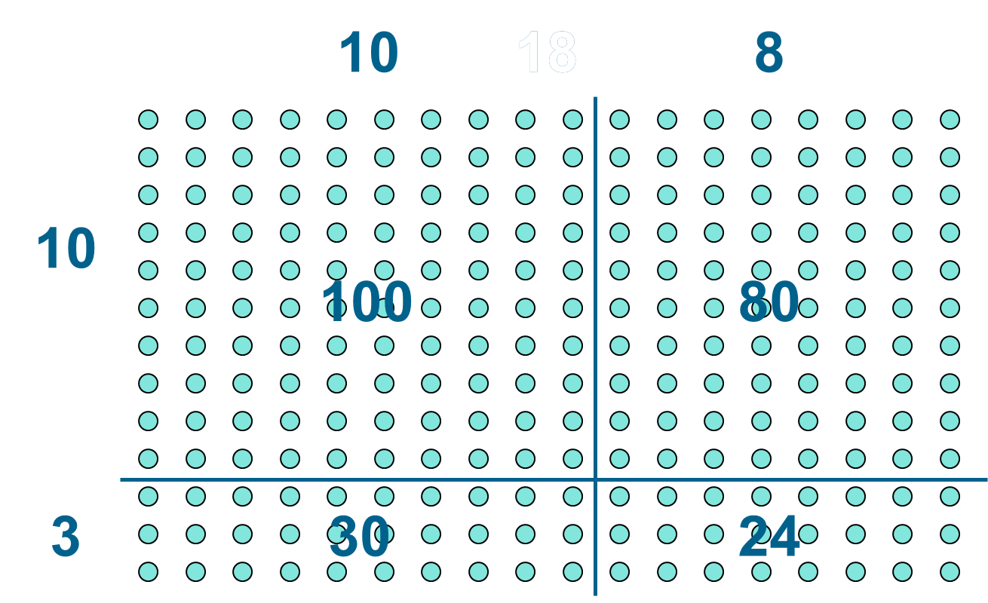
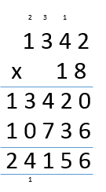
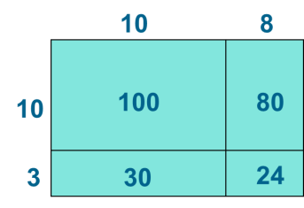
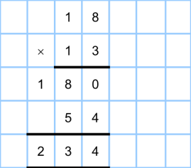
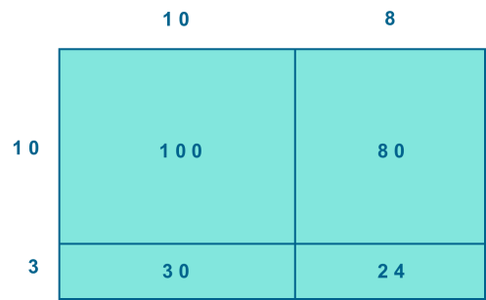
Year 4 | Year 5 | Year 6
Continue with a range of equations as in Year 2 but with appropriate numbers. Also include equations with missing digits. 2 x 5 = 160 Mental methods Counting in multiples of 6, 7, 9, 25 and 1000, and steps of 1/100. Solving practical problems where children need to scale up. Relate to known number facts. (e.g. How tall would a 25cm sunflower be if it grew 6 times taller?) Written methods (progressing to 3d x 2d) Children to embed and deepen their understanding of the grid method to multiply up 2d x 2d. Ensure this is still linked back to their understanding of arrays and place value counters. | Continue with a range of equations as in Year 2 but with appropriate numbers. Also include equations with missing digits. Mental methods X by 10, 100, 1000 using moving digits ITP Use practical resources and jottings to explore equivalent statements (e.g. 4 x 35 = 2 x 2 x 35). Recall of prime numbers up 19 and identify prime numbers up to 100 (with reasoning). Solving practical problems where children need to scale up. Relate to known number facts. Identify factor pairs for numbers. Written methods (progressing to 4d x 2d) Long multiplication using place value counters. Children to explore how the grid method supports an understanding of long multiplication (for 2d x 2d). | Continue with a range of equations as in Year 2 but with appropriate numbers. Also include equations with missing digits Mental methods Identifying common factors and multiples of given numbers. Solving practical problems where children need to scale up. Relate to known number facts. Written methods Continue to refine and deepen understanding of written methods including fluency for using long multiplication.
Obj
Gui
Vid
Ex
Obj
Gui
Vid
Ex
Obj
Gui
Vid
Ex

Slide 10
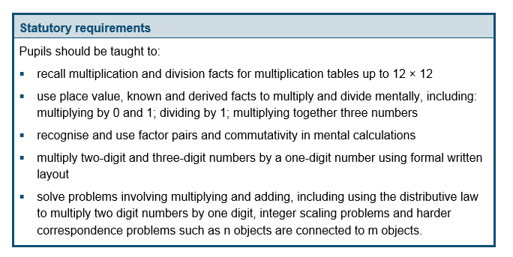
The National Curriculum in England
Year 4 Objectives
Return

Slide 11
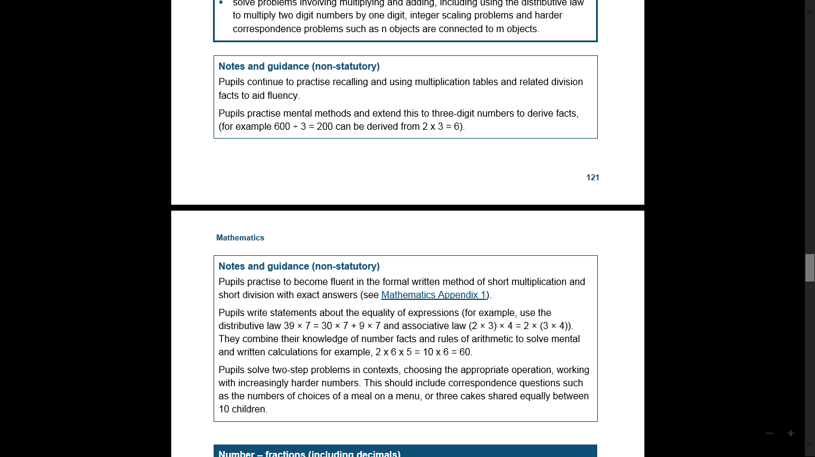
The National Curriculum in England
Year 4 Guidance
Return

Slide 12
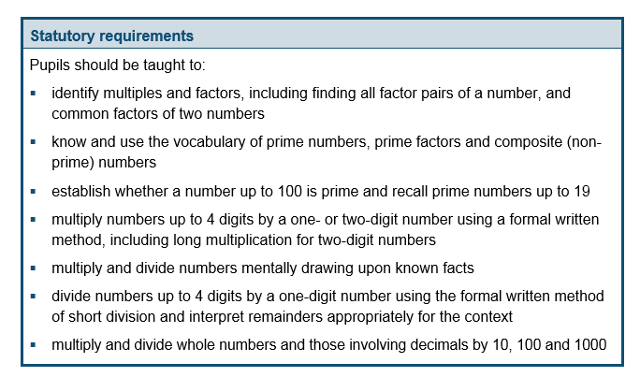
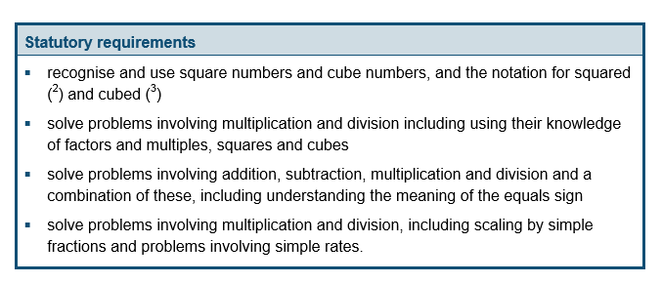
The National Curriculum in England
Year 5 Objectives
Return

Slide 13
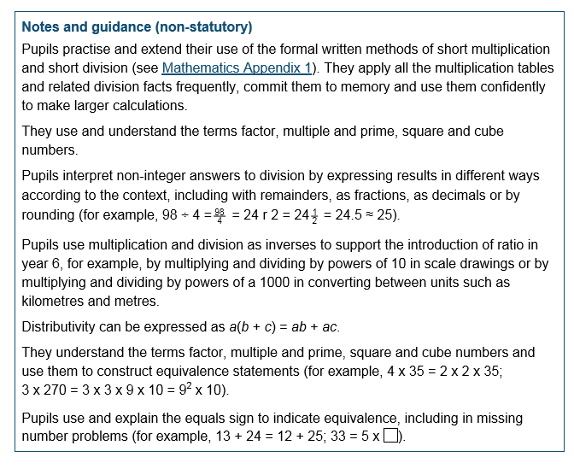
The National Curriculum in England
Year 5 Guidance
Return

Slide 14
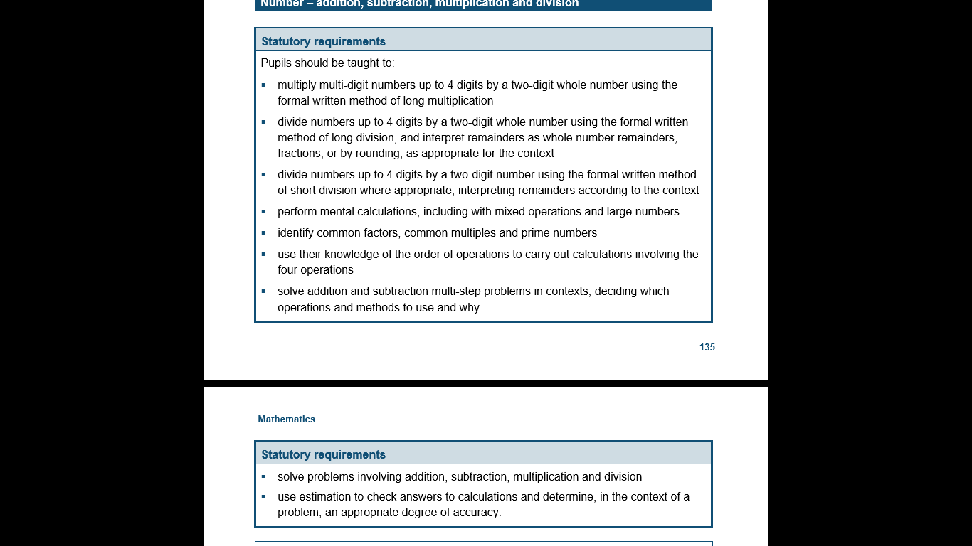
The National Curriculum in England
Year 6 Objectives
Return

Slide 15
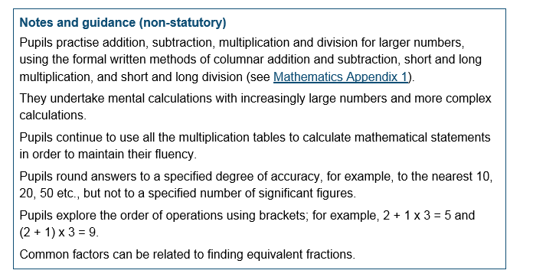
The National Curriculum in England
Year 6 Guidance
Return

