Slide 1

Calculation Policy Division – Years 1-6
Aintree Davenhill Primary School

Slide 2

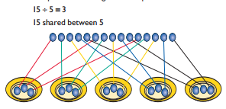
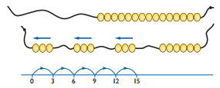

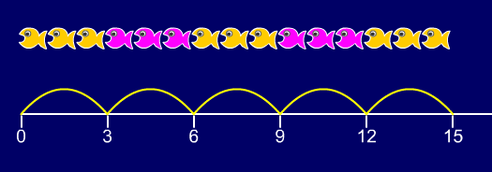


Year 1 | Year 2 | Year 3
Children must have secure counting skills – being able to confidently count in 2s, 5s and 10s. Children should be given opportunities to reason about what they notice in number patterns. Group AND share small quantities - understanding the difference between the two concepts. Sharing Develops importance of one-to-one correspondence. Children should be taught to share using concrete apparatus. Grouping Children should apply their counting skills to develop some understanding of grouping. Use of arrays as a pictorial representation for division. 15 ÷ 3 = 5 There are 5 groups of 3. 15 ÷ 5 = 3 There are 3 groups of 5. Children should be able to find ½ and ¼ and simple fractions of objects, numbers and quantities. | ÷ = signs and missing numbers 6 ÷ 2 = = 6 ÷ 2 6 ÷ = 3 3 = 6 ÷ ÷ 2 = 3 3 = ÷ 2 ÷ ∇ = 3 3 = ÷ ∇ Know and understand sharing and grouping – introducing children to the ÷ sign. Children should continue to use grouping and sharing for division using practical apparatus, arrays and pictorial representations. Grouping using a numberline Group from zero in jumps of the divisor to find out: ‘How many groups of 3 are there in 15?’. 15 ÷ 3 = 5 Continue work on arrays. Support children to understand how multiplication and division are inverse. Look at an array – what do you see? | ÷ = signs and missing numbers Continue using a range of equations as in year 2 but with appropriate numbers. Grouping How many 6s are in 30? 30 ÷ 6 can be modelled as: Becoming more efficient using a numberline Children need to be able to partition the dividend in different ways. 48 ÷ 4 = 12 +40 + 8 10 groups 2 groups Remainders 49 ÷ 4 = 12 r1 +40 + 8 + 1 10 groups 2 groups Sharing – 49 shared between 4. How many left over? Grouping – How many 4s make 49. How many are left over? Place value counters can be used to support children apply their knowledge of grouping. For example: 60 ÷ 10 = How many groups of 10 in 60? 600 ÷ 100 = How many groups of 100 in 600?
Obj
Gui
Vid
Ex
Obj
Gui
Vid
Ex
Obj
Gui
Vid
Ex

Slide 3
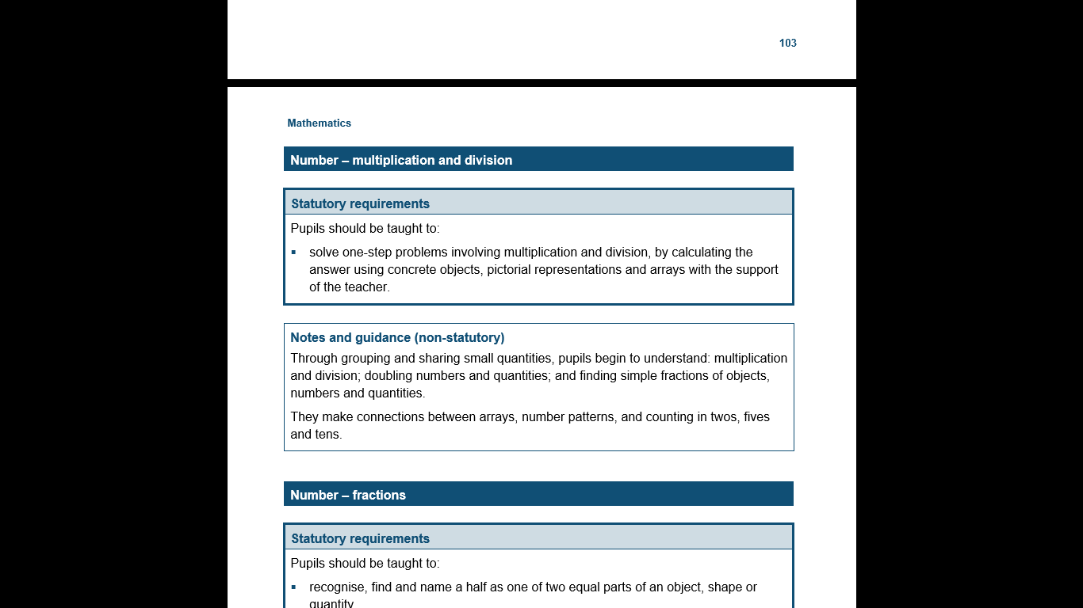
The National Curriculum in England Year 1 Objectives
Return

Slide 4
The National Curriculum in England Year 1 Guidance
Return

Slide 5
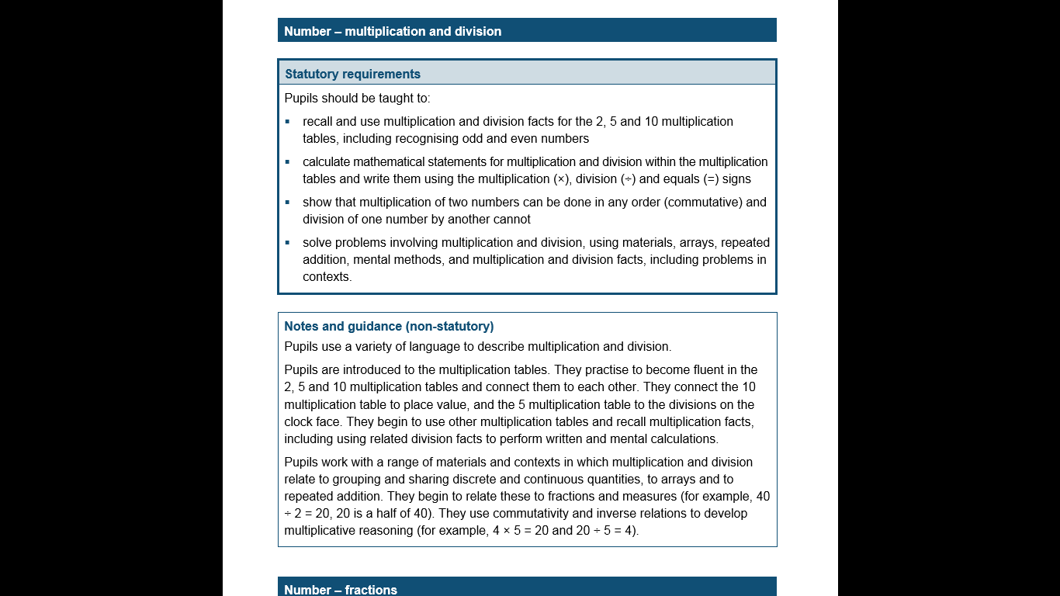
The National Curriculum in England Year 2 Objectives
Return

Slide 6
The National Curriculum in England Year 2 Guidance
Return

Slide 7
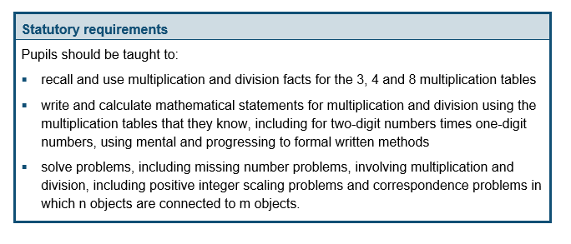
The National Curriculum in England Year 3 Objectives
Return

Slide 8
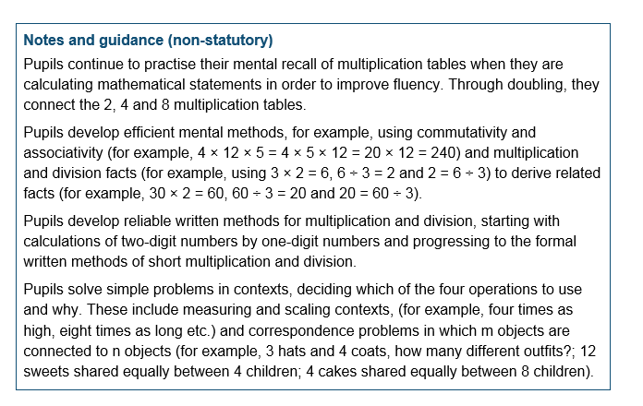
The National Curriculum in England Year 3 Guidance
Return

Slide 9
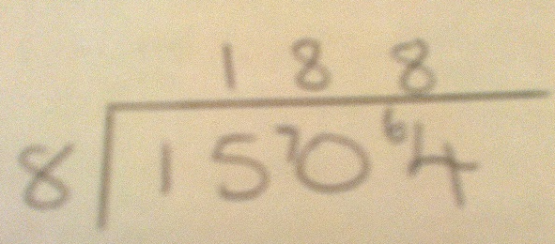
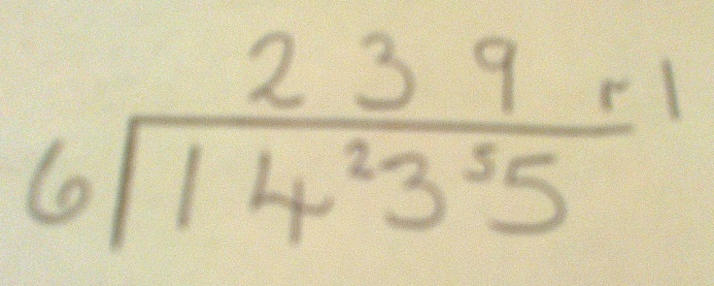
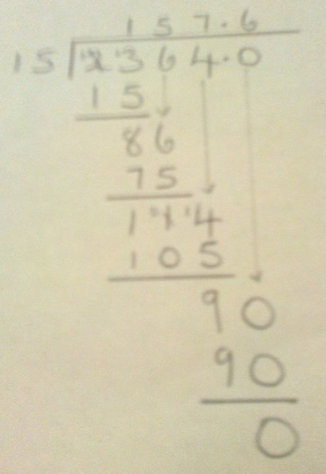
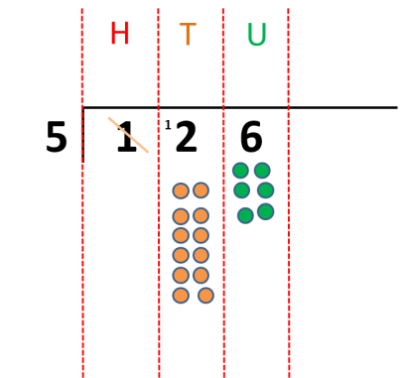
Year 4 | Year 5 | Year 6
÷ = signs and missing numbers Continue using a range of equations as in year 3 but with appropriate numbers. Sharing, Grouping and using a number line Children will continue to explore division as sharing and grouping, and to represent calculations on a number line until they have a secure understanding. Children should progress in their use of written division calculations: Using tables facts with which they are fluent Experiencing a logical progression in the numbers they use, for example: Dividend just over 10x the divisor, e.g. 84 ÷ 7 Dividend just over 10x the divisor when the divisor is a teen number, e.g. 173 ÷ 15 (learning sensible strategies for calculations such as 102 ÷ 17) Dividend over 100x the divisor, e.g. 840 ÷ 7 Dividend over 20x the divisor, e.g. 168 ÷ 7 All of the above stages should include calculations with remainders as well as without. Remainders should be interpreted according to the context. (i.e. rounded up or down to relate to the answer to the problem) |  | ÷ = signs and missing numbers Continue using a range of equations but with appropriate numbers Sharing and Grouping and using a number line Children will continue to explore division as sharing and grouping, and to represent calculations on a number line as appropriate. Quotients should be expressed as decimals and fractions Formal Written Methods – long and short division E.g. 1504 ÷ 8 E.g. 2364 ÷ 15
Formal Written Methods Formal short division should only be introduced once children have a good understanding of division, its links with multiplication and the idea of ‘chunking up’ to find a target number (see use of number lines above) Short division to be modelled for understanding using place value counters as shown below. Calculations with 2 and 3-digit dividends. E.g. fig 1 | Formal Written Methods Continued as shown in Year 4, leading to the efficient use of a formal method. The language of grouping to be used (see link from fig. 1 in Year 4) E.g. 1435 ÷ 6 Children begin to practically develop their understanding of how express the remainder as a decimal or a fraction. Ensure practical understanding allows children to work through this (e.g. what could I do with this remaining 1? How could I share this between 6 as well?)
Obj
Gui
Vid
Ex
Obj
Gui
Vid
Ex
Obj
Gui
Vid
Ex
Jottings
7 x 100 = 700
7 x 10 = 70
7 x 20 = 140
e.g. 840 ÷ 7 = 120
0
140
840
20 groups
100 groups

Slide 10
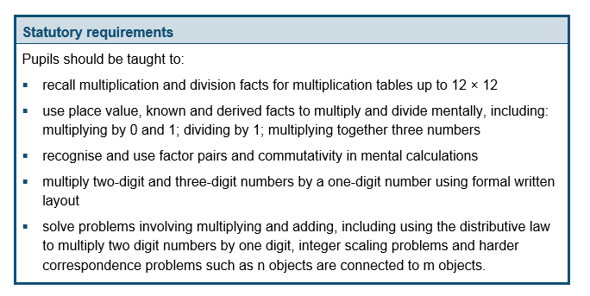
The National Curriculum in England Year 4 Objectives
Return

Slide 11
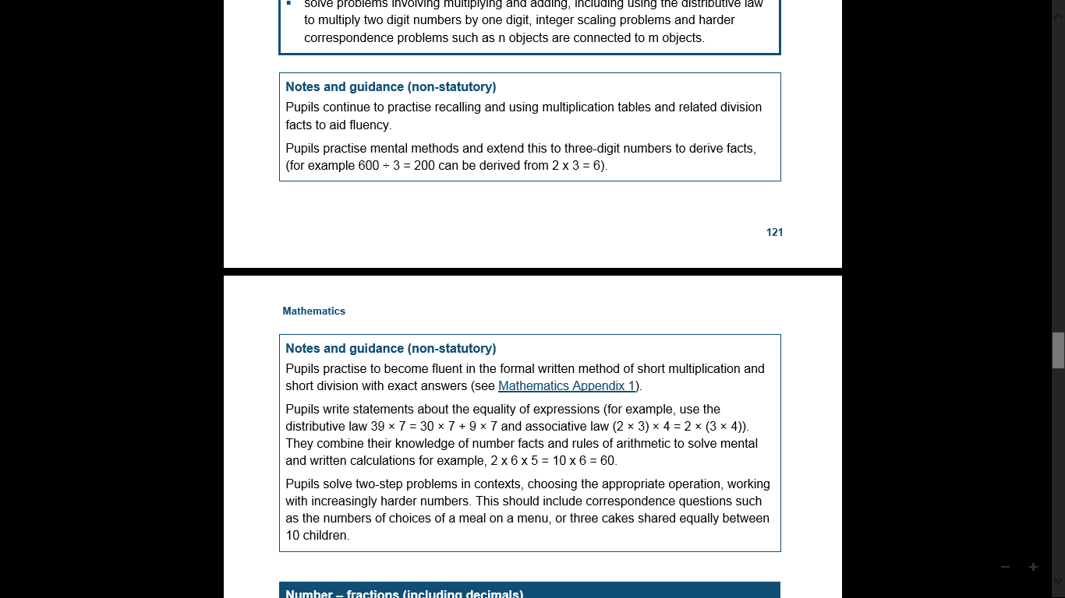
The National Curriculum in England Year 4 Guidance
Return

Slide 12
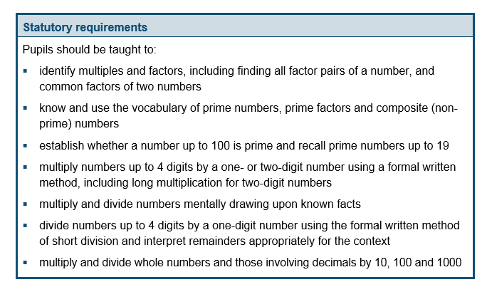
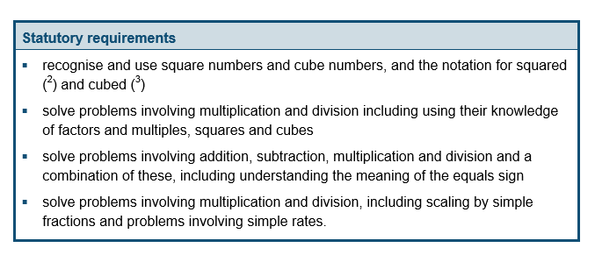
The National Curriculum in England Year 5 Objectives
Return

Slide 13
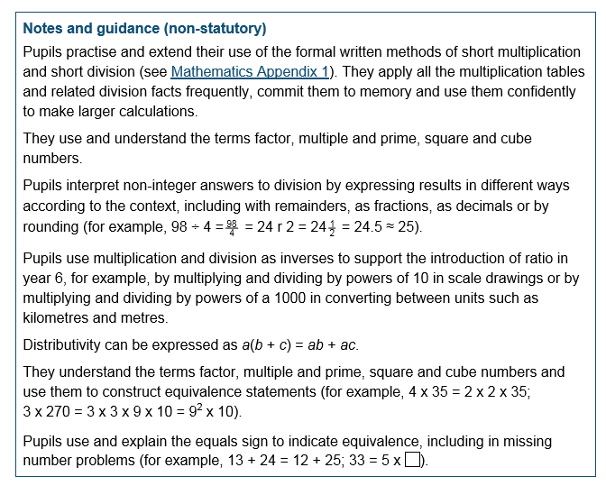
The National Curriculum in England Year 5 Guidance
Return

Slide 14
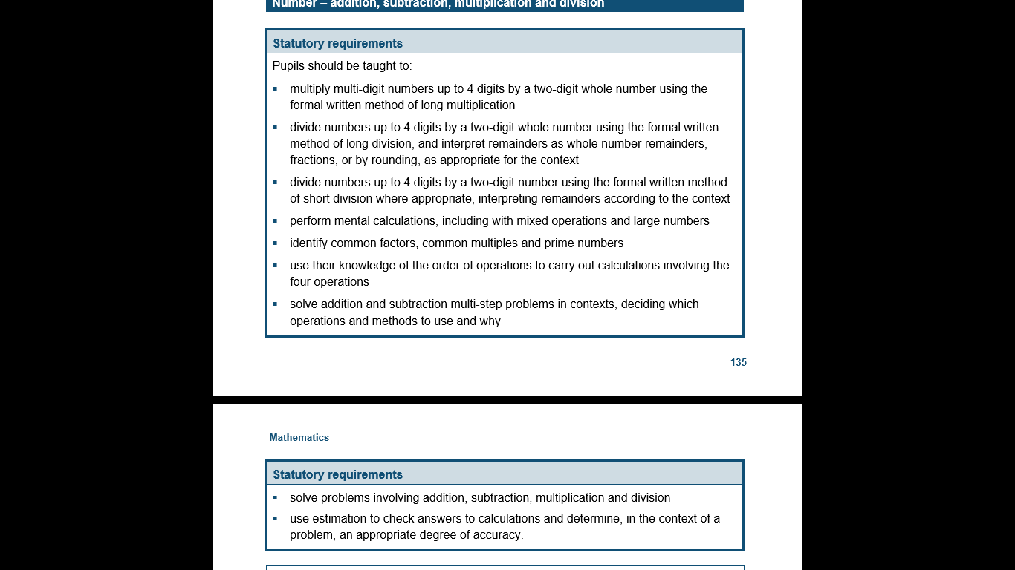
The National Curriculum in England Year 6 Objectives
Return

Slide 15
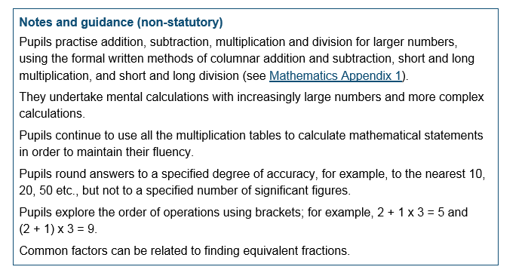
The National Curriculum in England Year 6 Guidance
Return

