Slide 1

Calculation Policy Addition – Years 1-6
Aintree Davenhill Primary School

Slide 2

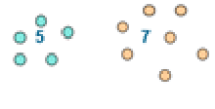

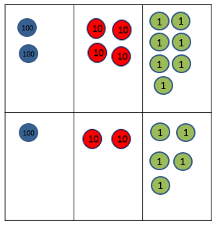



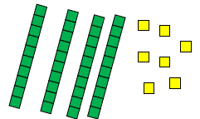
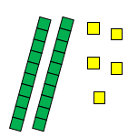
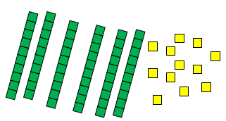
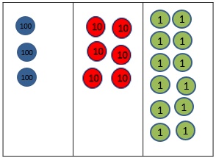
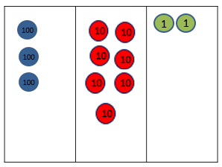
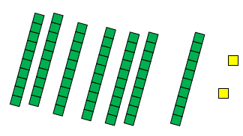


Year 1 | Year 2 | Year 3
+ = signs and missing numbers Children need to understand the concept of equality before using the ‘=’ sign. Calculations should be written either side of the equality sign so that the sign is not just interpreted as ‘the answer’. 2 = 1+ 1 2 + 3 = 4 + 1 Missing numbers need to be placed in all possible places. 3 + 4 = = 3 + 4 3 + = 7 7 = + 4 Counting and combining sets of objects Combining two sets of objects (aggregation) which will progress onto adding on to a set (augmentation). Understanding of counting on with a numbertrack Understanding of counting on with a numberline (supported by models and images) 7+ 4 | Missing number problems, e.g. 14 + 5 = 10 + 32 + + = 100 35 = 1 + + 5. It is valuable to use a range of representations (also see Y1). Continue to use numberlines to develop understanding of: Counting on in tens and ones 23 + 12 = 23 + 10 + 2 = 33 + 2 = 35 Partitioning and bridging through 10 The steps in addition often bridge through a multiple of 10 e.g. children should be able to partition the 7 to relate adding the 2 and then the 5. 8 + 7 = 15 Adding 9 or 11 by adding 10 and adjusting by 1 e.g. add 9 by adding 10 and adjusting by 1. 35 + 9 = 44 Towards a Written Method Partitioning in different ways and recombine 47 + 25 47 25 60 + 12 Leading to exchanging: 72 Expanded written method 40 + 7 + 20 + 5 = 40+20 + 7 + 5 = 60 + 12 = 72 | Missing number problems using a range of equations as in Year 1 and 2 but with appropriate, larger numbers. Partition into tens and ones Partition both numbers and recombine. Count on by partitioning the second number only. 247 + 125 = 247 + 100 + 20+ 5 = 347 + 20 + 5 = 367 + 5 = 372 Children need to be secure adding multiples of 100 and 10 to any three-digit number including those that are not multiples of 10. Towards a Written Method Introduce expanded column addition modelled with place value counters. (Dienes could be used for those who need a less abstract representation.) Leading to children understanding the exchange between tens and ones. Some children may begin to use a formal columnar algorithm, initially introduced alongside the expanded method. The formal method should be seen as a more streamlined version of the expanded method, not a new method.
Obj
Gui
Vid
Ex
Obj
Gui
Vid
Ex
Obj
Gui
Vid
Ex

Slide 3
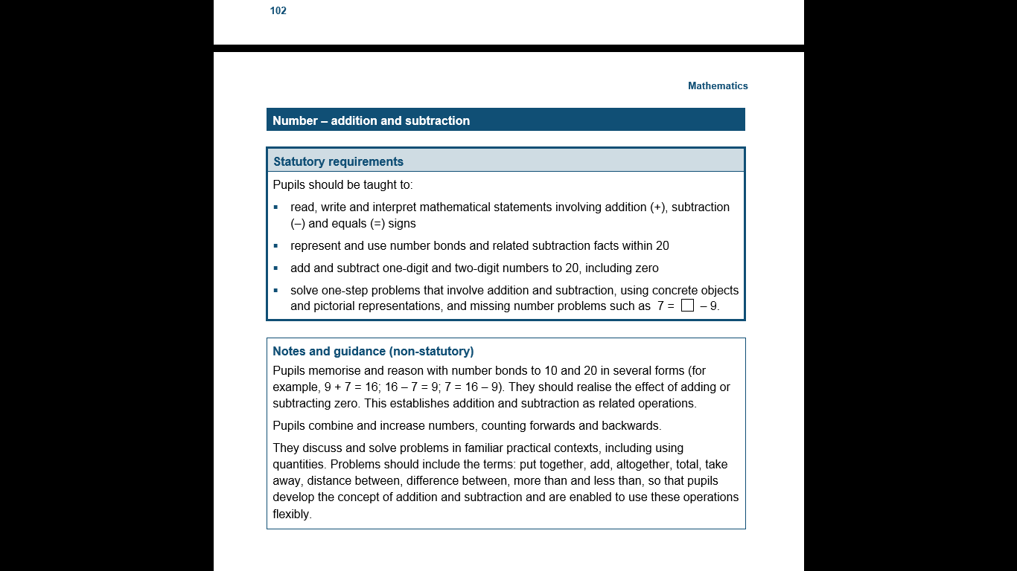
The National Curriculum in England Year 1 Objectives
Return

Slide 4
The National Curriculum in England Year 1 Guidance
Return

Slide 5
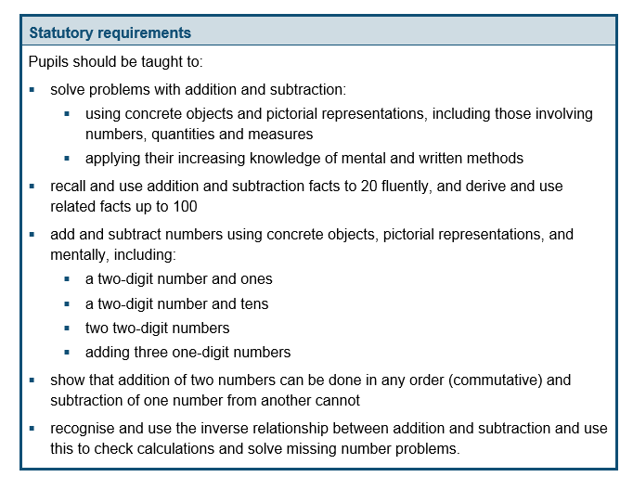
The National Curriculum in England Year 2 Objectives
Return

Slide 6
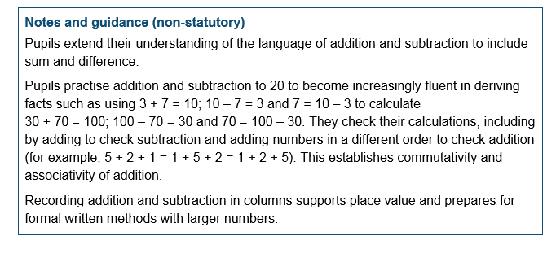
The National Curriculum in England Year 2 Guidance
Return

Slide 7
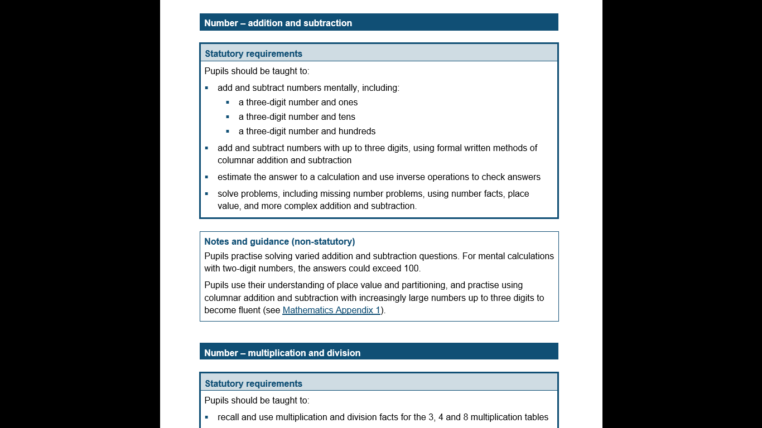
The National Curriculum in England Year 3 Objectives
Return

Slide 8
The National Curriculum in England Year 3 Guidance
Return

Slide 9
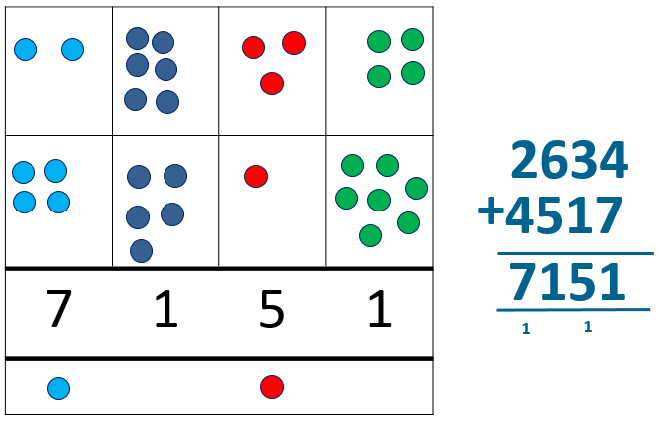
Year 4 | Year 5 | Year 6
Missing number/digit problems: Mental methods should continue to develop, supported by a range of models and images, including the number line. Written methods (progressing to 4-digits) Expanded column addition modelled with place value counters, progressing to calculations with 4-digit numbers. Compact written method Extend to numbers with at least four digits. Children should be able to make the choice of reverting to expanded methods if experiencing any difficulty. Extend to up to two places of decimals (same number of decimals places) and adding several numbers (with different numbers of digits). 72.8 + 54.6 127.4 1 1 | Missing number/digit problems: Mental methods should continue to develop, supported by a range of models and images, including the number line. Children should practise with increasingly large numbers to aid fluency. 12462 + 2300 = 14762 Written methods (progressing to more than 4-digits) As Year 4, progressing when understanding of the expanded method is secure, children will move on to the formal columnar method for whole numbers and decimal numbers as an efficient written algorithm. 172.83 + 54.68 227.51 1 1 1 Place value counters can be used alongside the columnar method to develop understanding of addition with decimal numbers. | Missing number/digit problems: Mental methods should continue to develop, supported by a range of models and images, including the number line. Written methods As Year 5, progressing to larger numbers, aiming for both conceptual understanding and procedural fluency with columnar method to be secured. Continue calculating with decimals, including those with different numbers of decimal places. Problem Solving Teachers should ensure that pupils have the opportunity to apply their knowledge in a variety of contexts and problems (exploring cross curricular links) to deepen their understanding. .
Obj
Gui
Ex
Obj
Gui
Ex
Obj
Gui
Ex

Slide 10
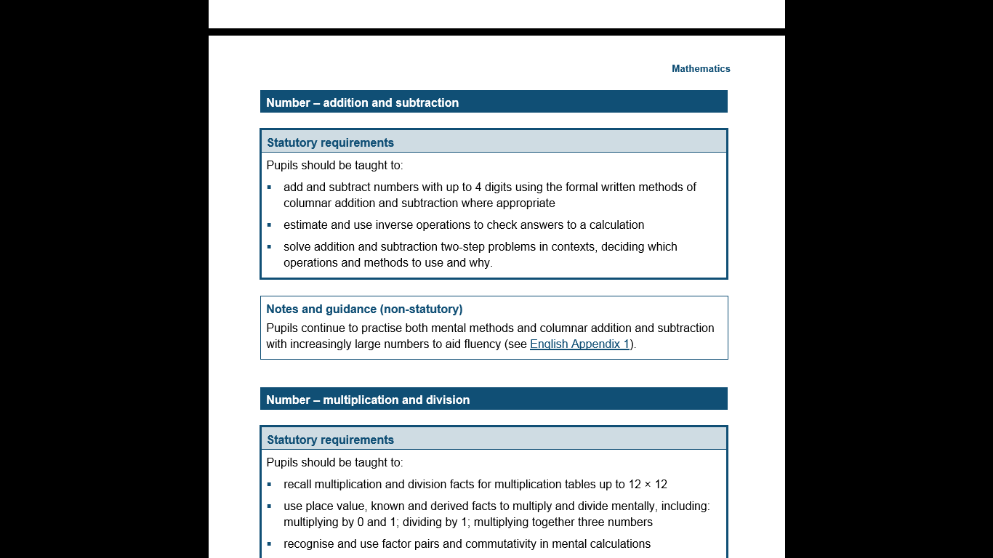
The National Curriculum in England Year 4 Objectives
Return

Slide 11
The National Curriculum in England Year 4 Guidance
Return

Slide 12
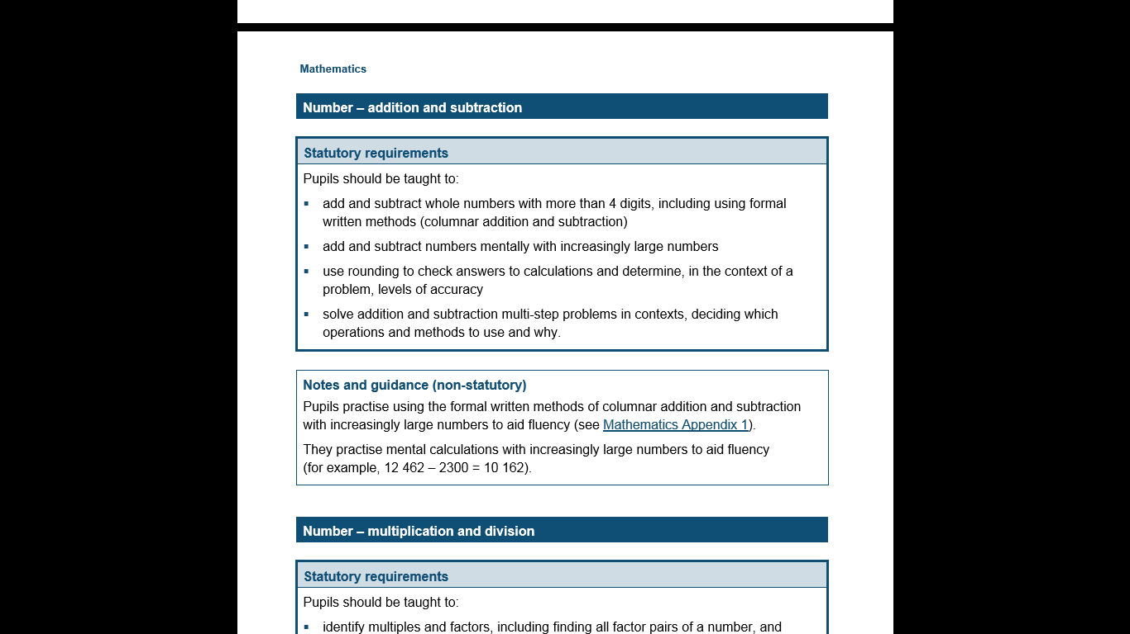
The National Curriculum in England Year 5 Objectives
Return

Slide 13
The National Curriculum in England Year 5 Guidance
Return

Slide 14
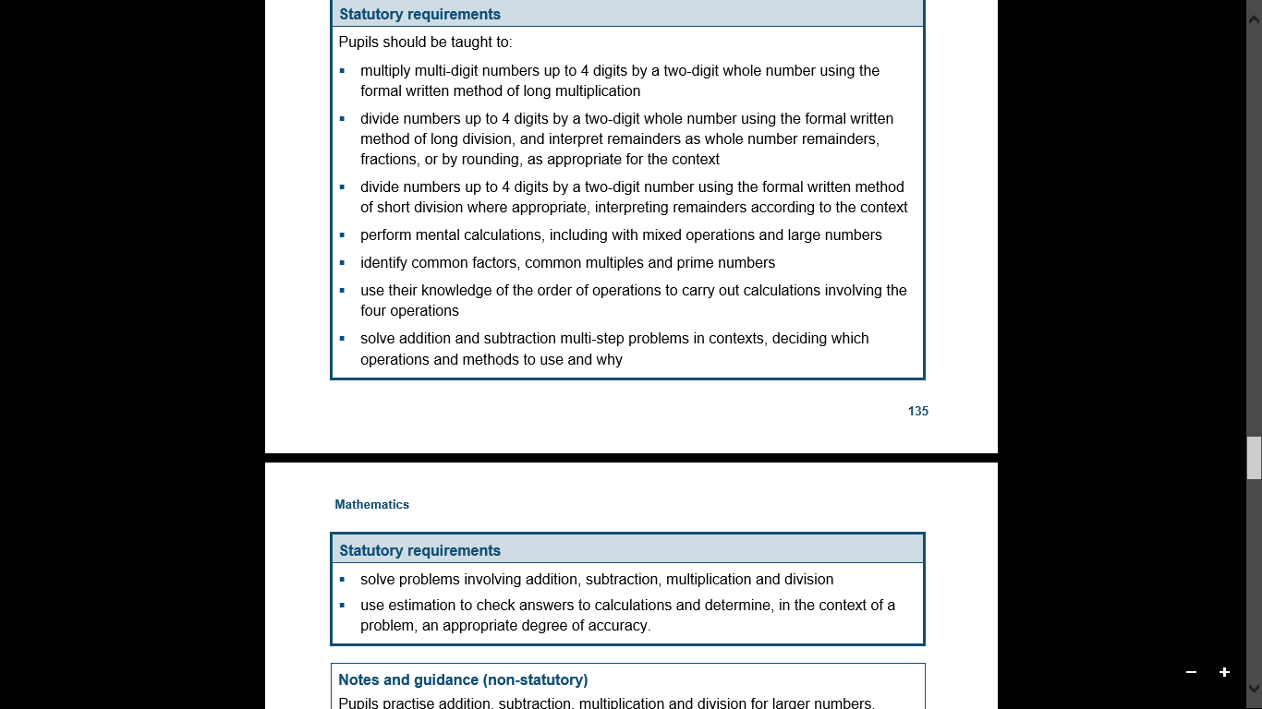
The National Curriculum in England Year 6 Objectives
Return

Slide 15
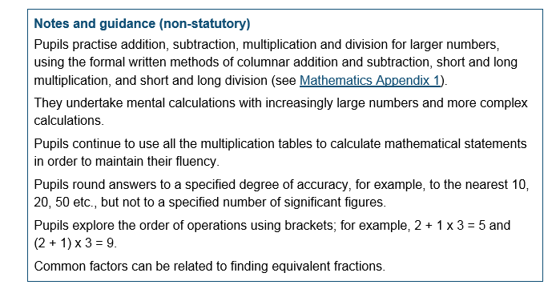
The National Curriculum in England Year 6 Guidance
Return

